Slide 1
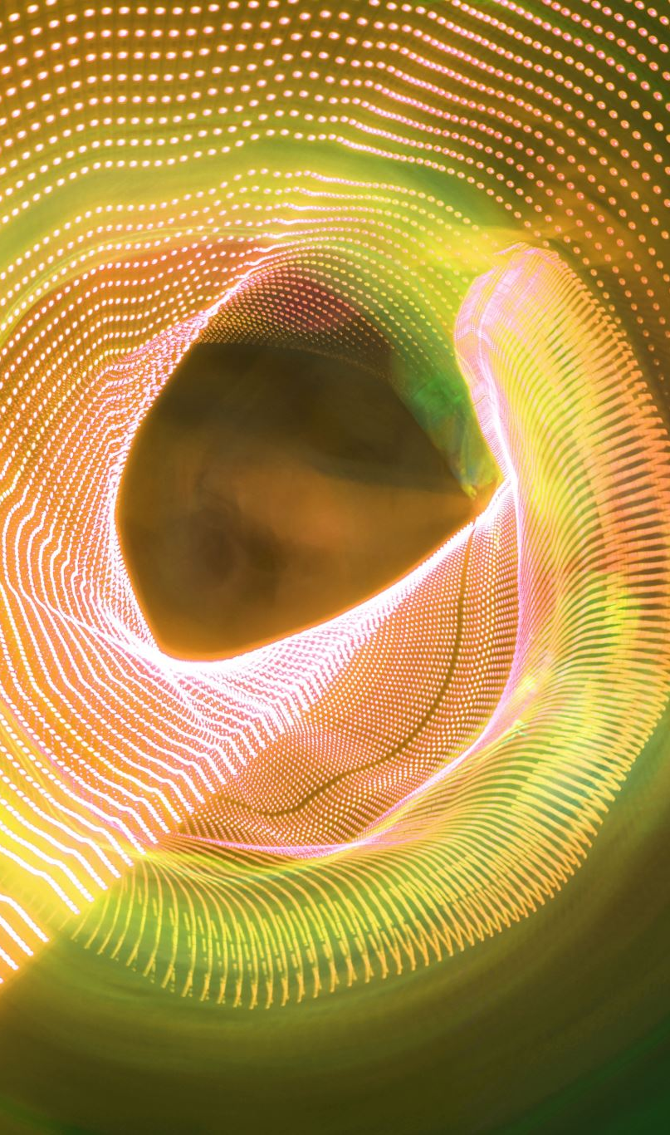
Simulating the Trajectory of Light Around A Black Hole
Group 4
Xavier Parker
Helitha Cooray
Aayan Islam

Slide 2
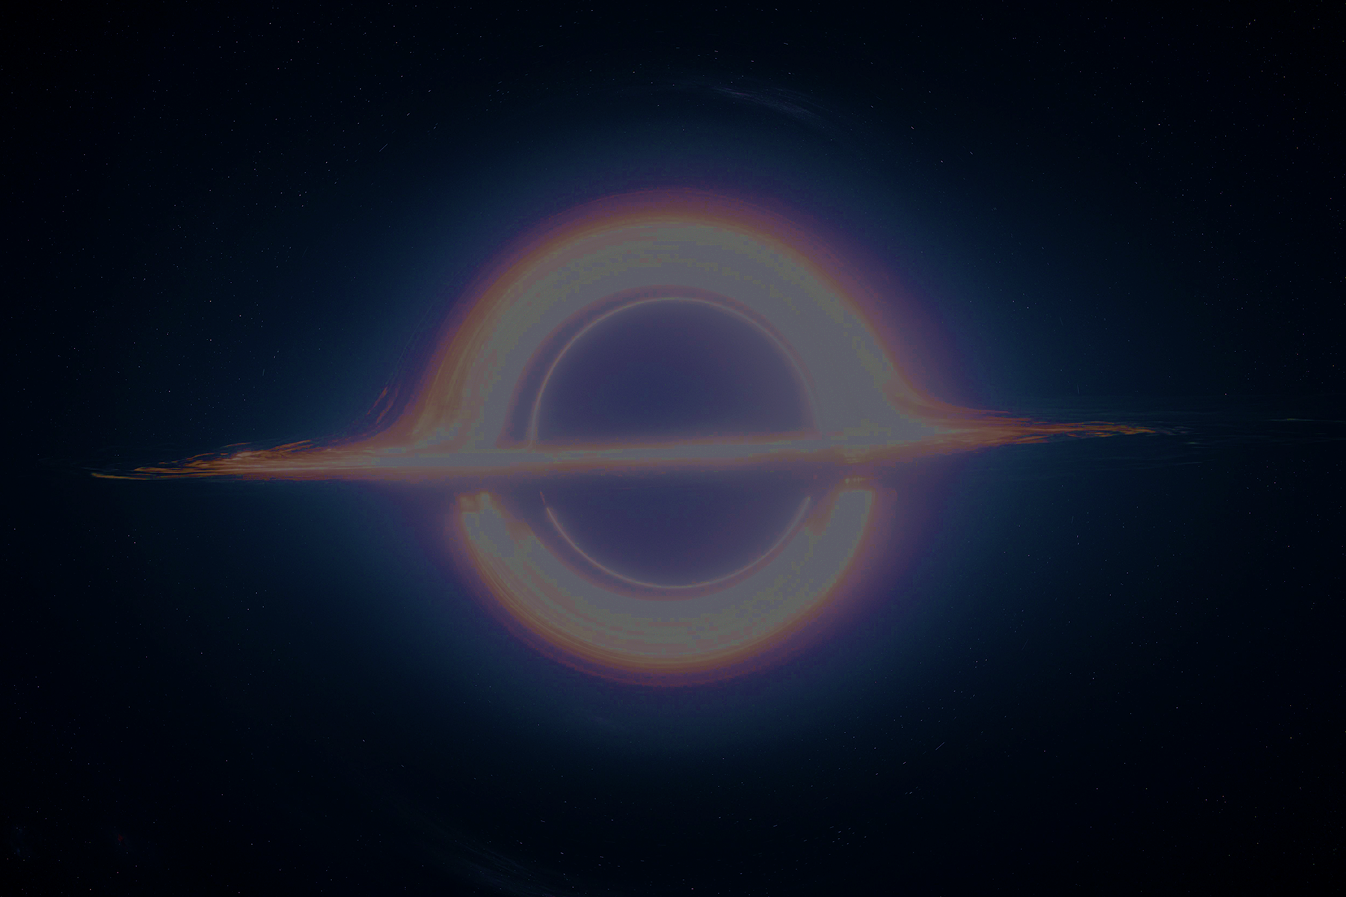
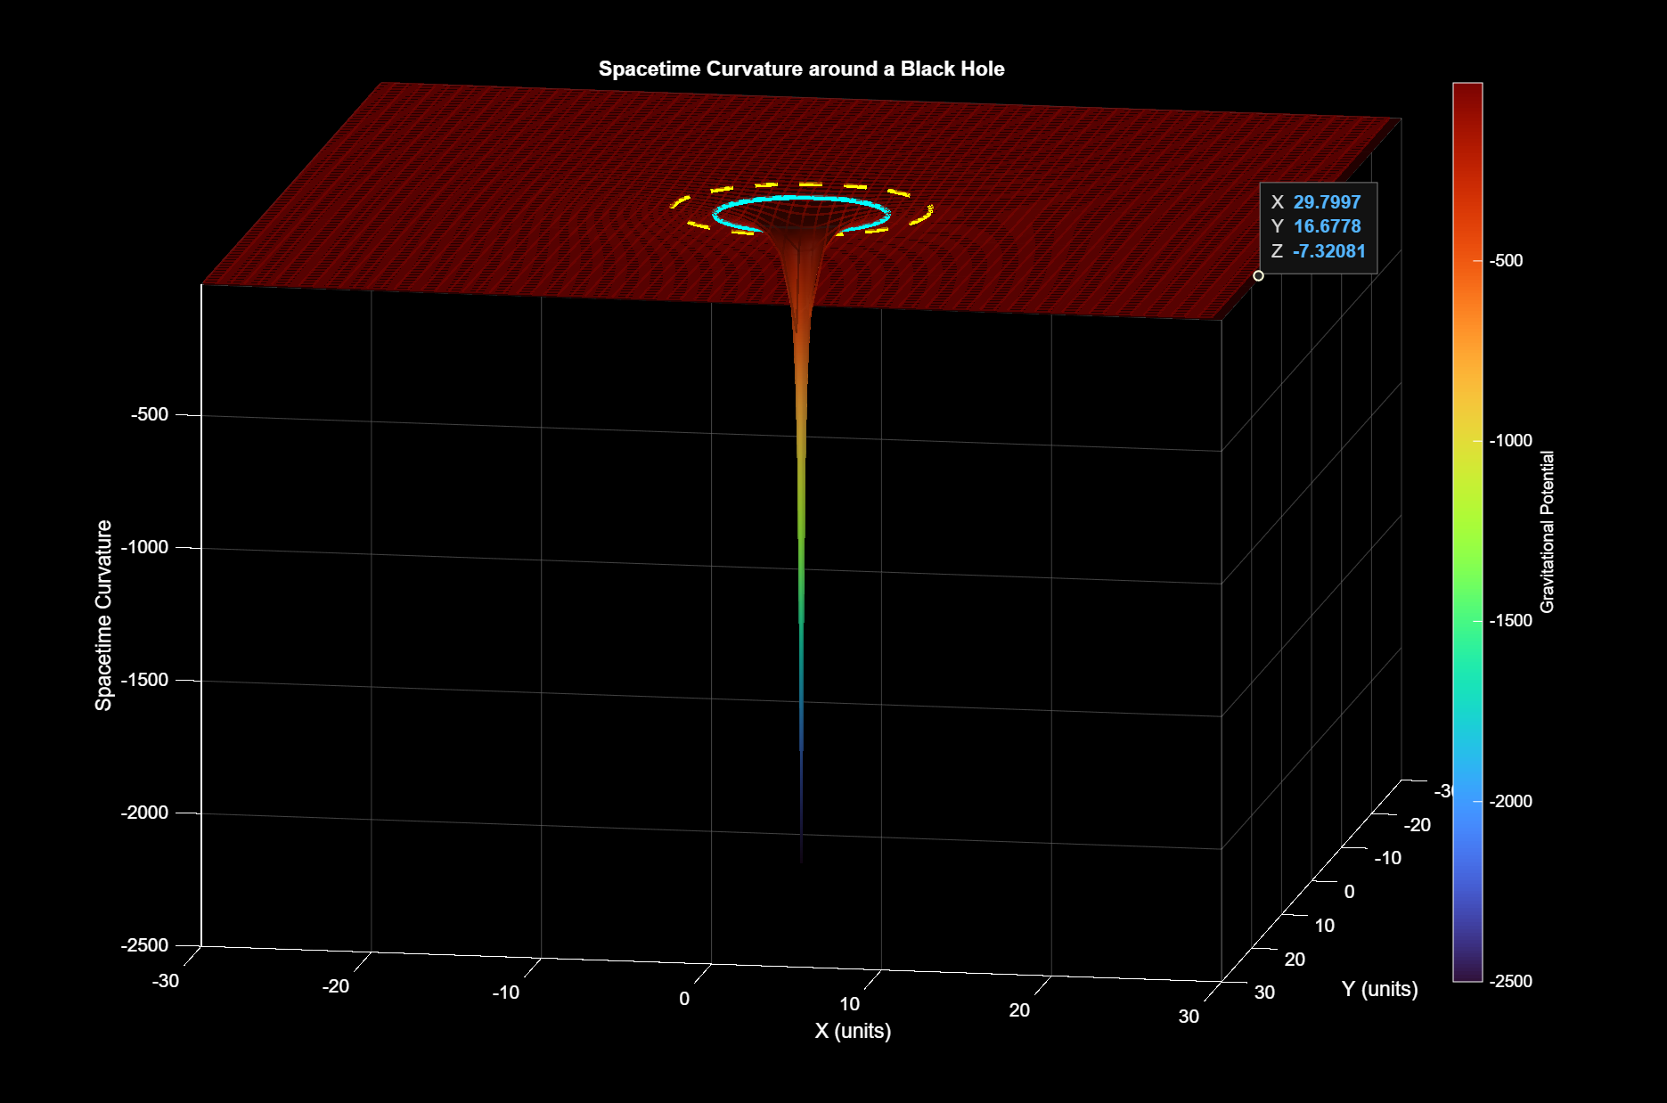
Introduction
Light bends in curved spacetime:
Photons follow the curvature of spacetime.
Spacetime "bends" in the presence of a massive object.
Geodesics = light's autopilot
Light travels along null geodesics - the straightest possible paths in spacetime.
Black holes are gravity gone wild
Results in the extreme curvature of surrounding spacetime, trapping any light going past the event horizon.
photon sphere
event horizon
Our goal: Simulate the behavior of light around a Schwarzchild (non-rotating, symmetric) black hole.
How: Solve the photon geodesics ODEs and use random sampling to generate light paths from different sources.
singularity
Notes:
Objective: Briefly outline the purpose of the project, including the main problem or system being modeled or simulated. (modelling how light travels through a black hole)
Our wording: "To model and simulate the trajectory of a light ray near a black hole."
Relevance to Course Topics:
Robotics (no real relevance)
Ordinary Differential Equations ( we use the geodesic equations and the Christoffel equations which are all ODEs)
Random Numbers and Probability (we implement random gaussian noise to model extra factors)
Statistics (uhm)
(Helitha)

Slide 3
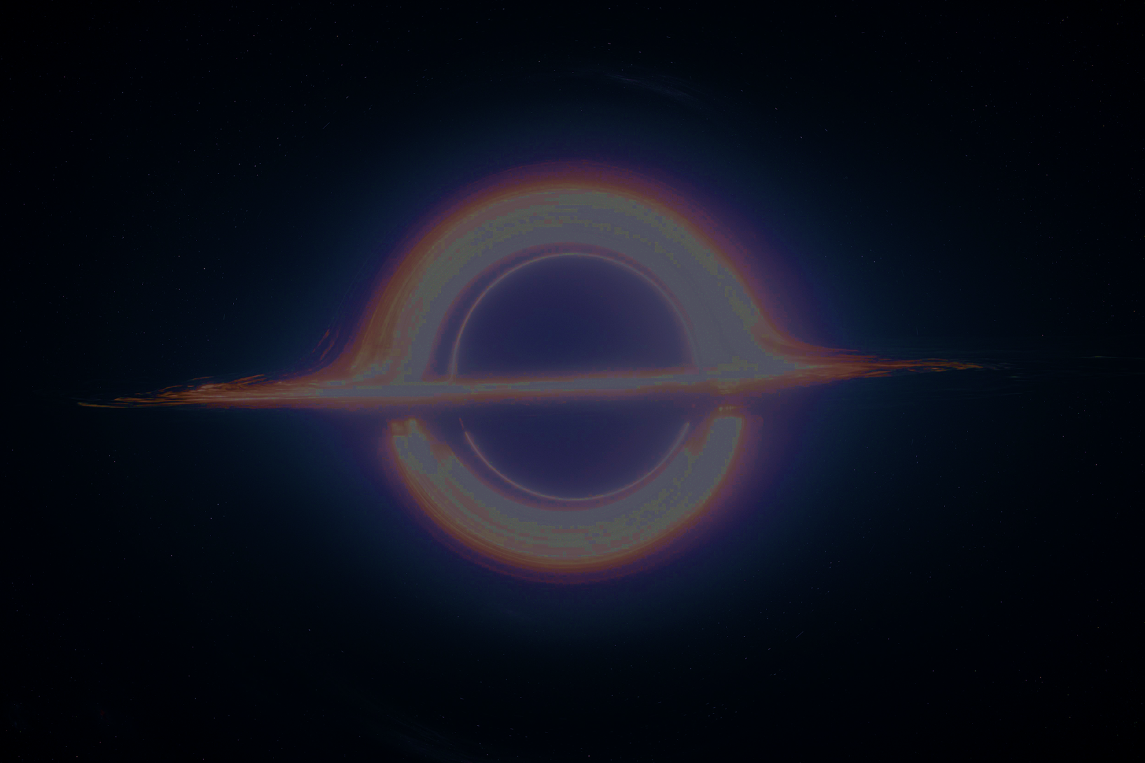
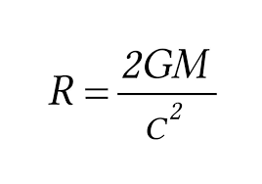
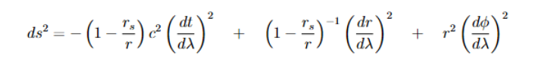
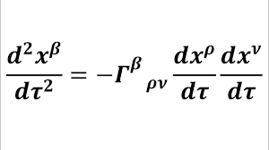
Background and Context
System Description
Modelling the path a ray of light takes when near a black hole
Done by using the geodesic equations and Christoffel symbols
Relevant Principles
Used ODEs to measure the change in angular distance and velocity.
Implemented Gaussian noise to account for real world uncertainties such as other fields and celestial bodies.
Schwarzschild radius
Affine Parameter
Geodesic equation
Christoffel symbols
Notes:
System Description:
Define the system being modeled.
Example: "A robotic arm with two degrees of freedom designed for object manipulation."
Relevant Principles:
ODEs: Use to model joint torque and angular motion.
Random Numbers: Simulate noise in sensor measurements.
Probability & Statistics: Analyse system performance metrics such as error rates or efficiency.
(Aayan)

Slide 4

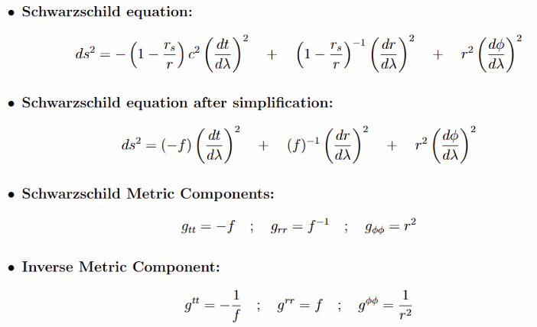
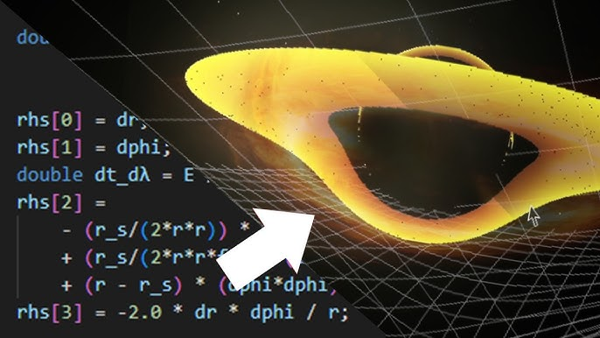
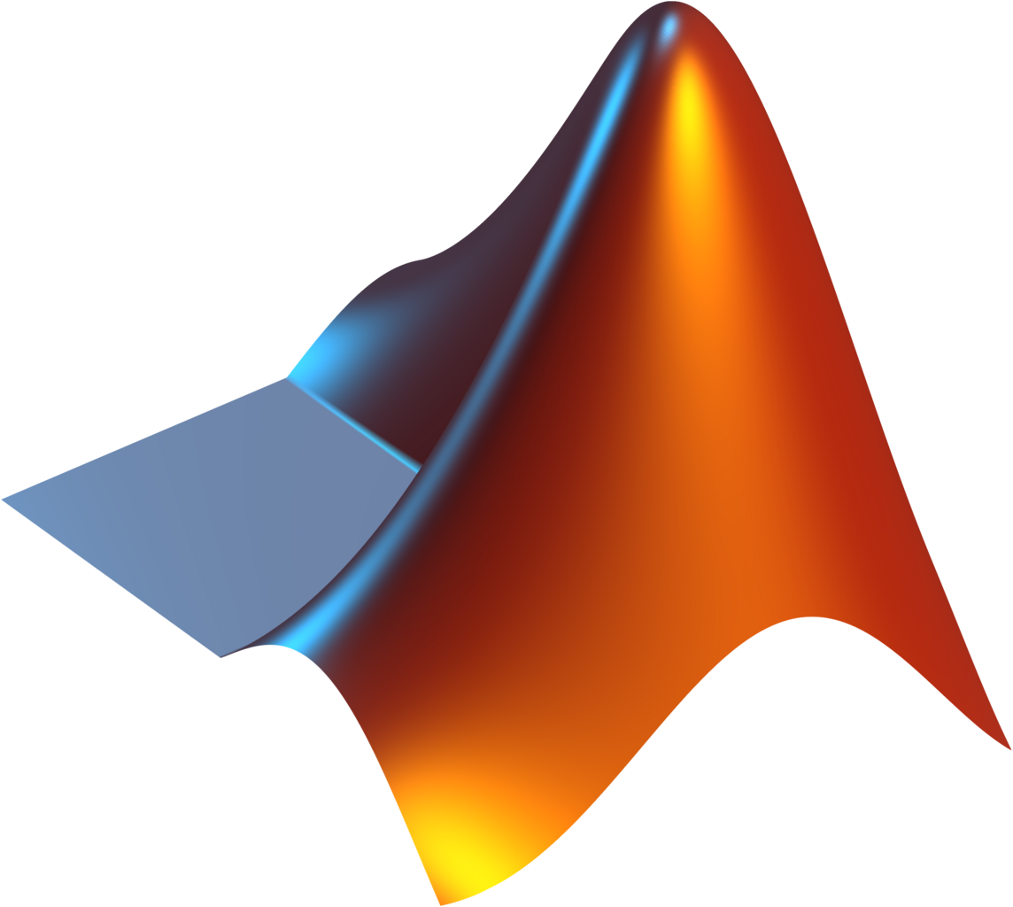
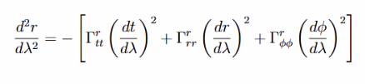
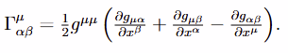
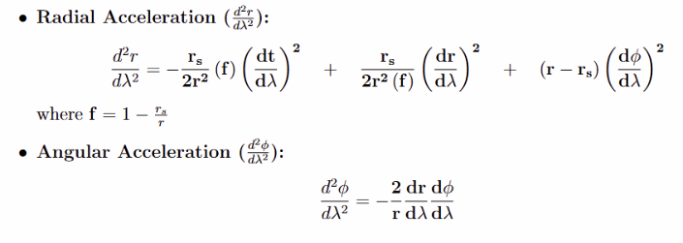
Methodology
How did we model this
Assume Null conditions (set the Schwarzschild equation to 0) .
Solve for each relevant Christoffel symbol.
What software did we use?
Why MATLAB?
Built-in ODE solvers
Easy to plot/ animate
https://youtu.be/8-B6ryuBkCM?si=WjboU6oqHqLiwGTd
Performance Metrics
Light gets pulled towards the black hole
Path deviation
Light spirals around the black hole and escapes
Light is completely absorbed by the black hole
Each simulation run is different
Notes:
Modeling Process:
Formulation of the ODEs:
Describe the equations governing the system's dynamics.
Example: Euler-Lagrange equations for robotic joint motion.
Statistical Modeling:
Define performance metrics.
Example: Evaluate positional accuracy using statistical tools like standard deviation.
Simulation Tools:
Mention software or frameworks used (e.g., MATLAB, Python libraries, ROS).
Discuss reasons for selection.
Random Number Integration:
Example: "Gaussian noise was added to simulate sensor errors.“
(Aayan)

Slide 5
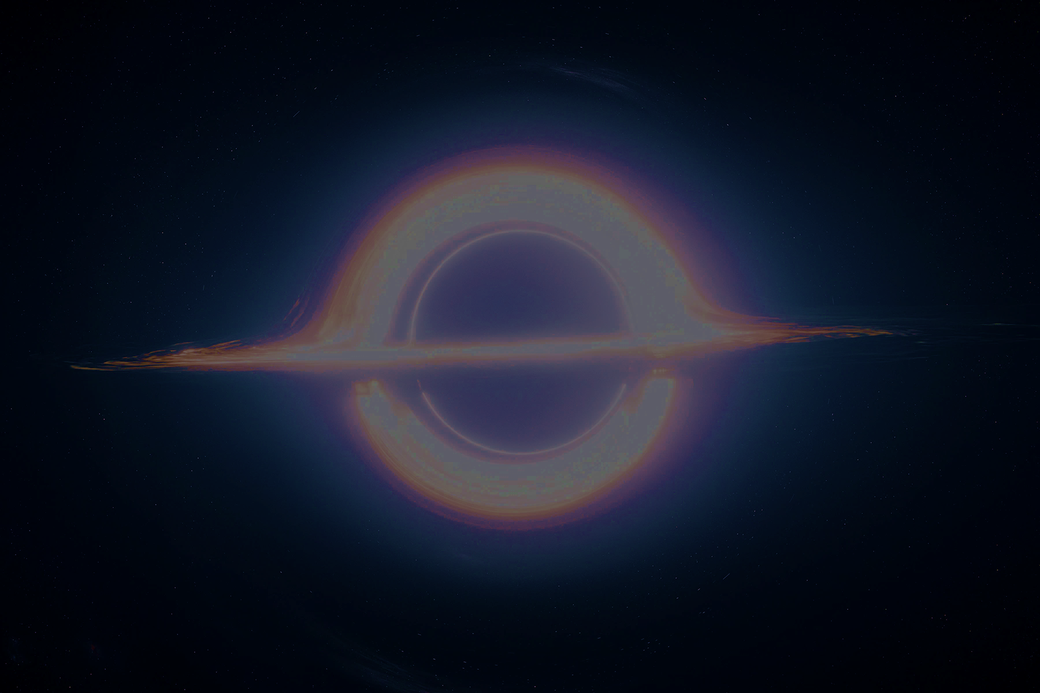
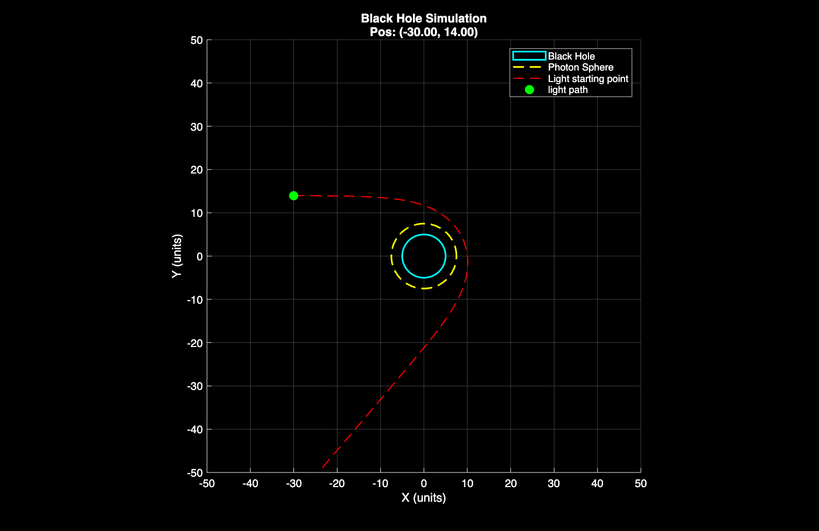
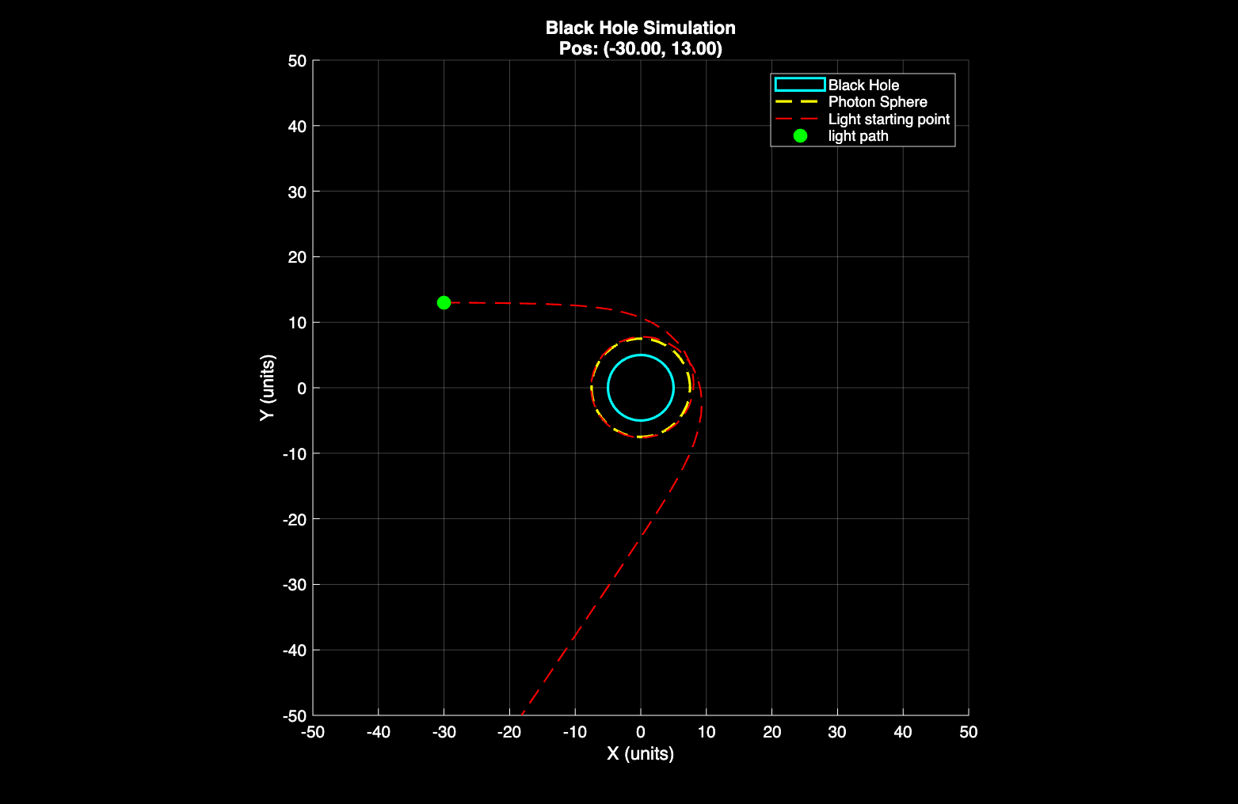
Preliminary Results
Notes:
This is where we include our figures. Could have 2 slides for these. Not much talking (just some images initially)
(Xavier)

Slide 6
Notes:
(Xavier)

Slide 7
Notes:
(Xavier)

Slide 8
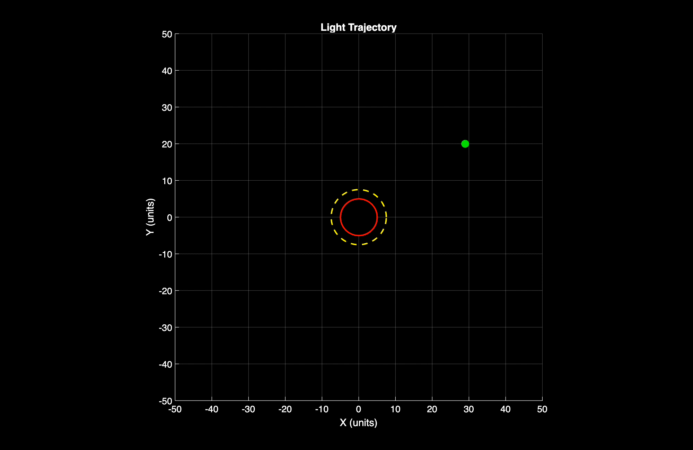
Notes:
(Xavier)

Slide 9
Notes:
(Xavier)

Slide 10
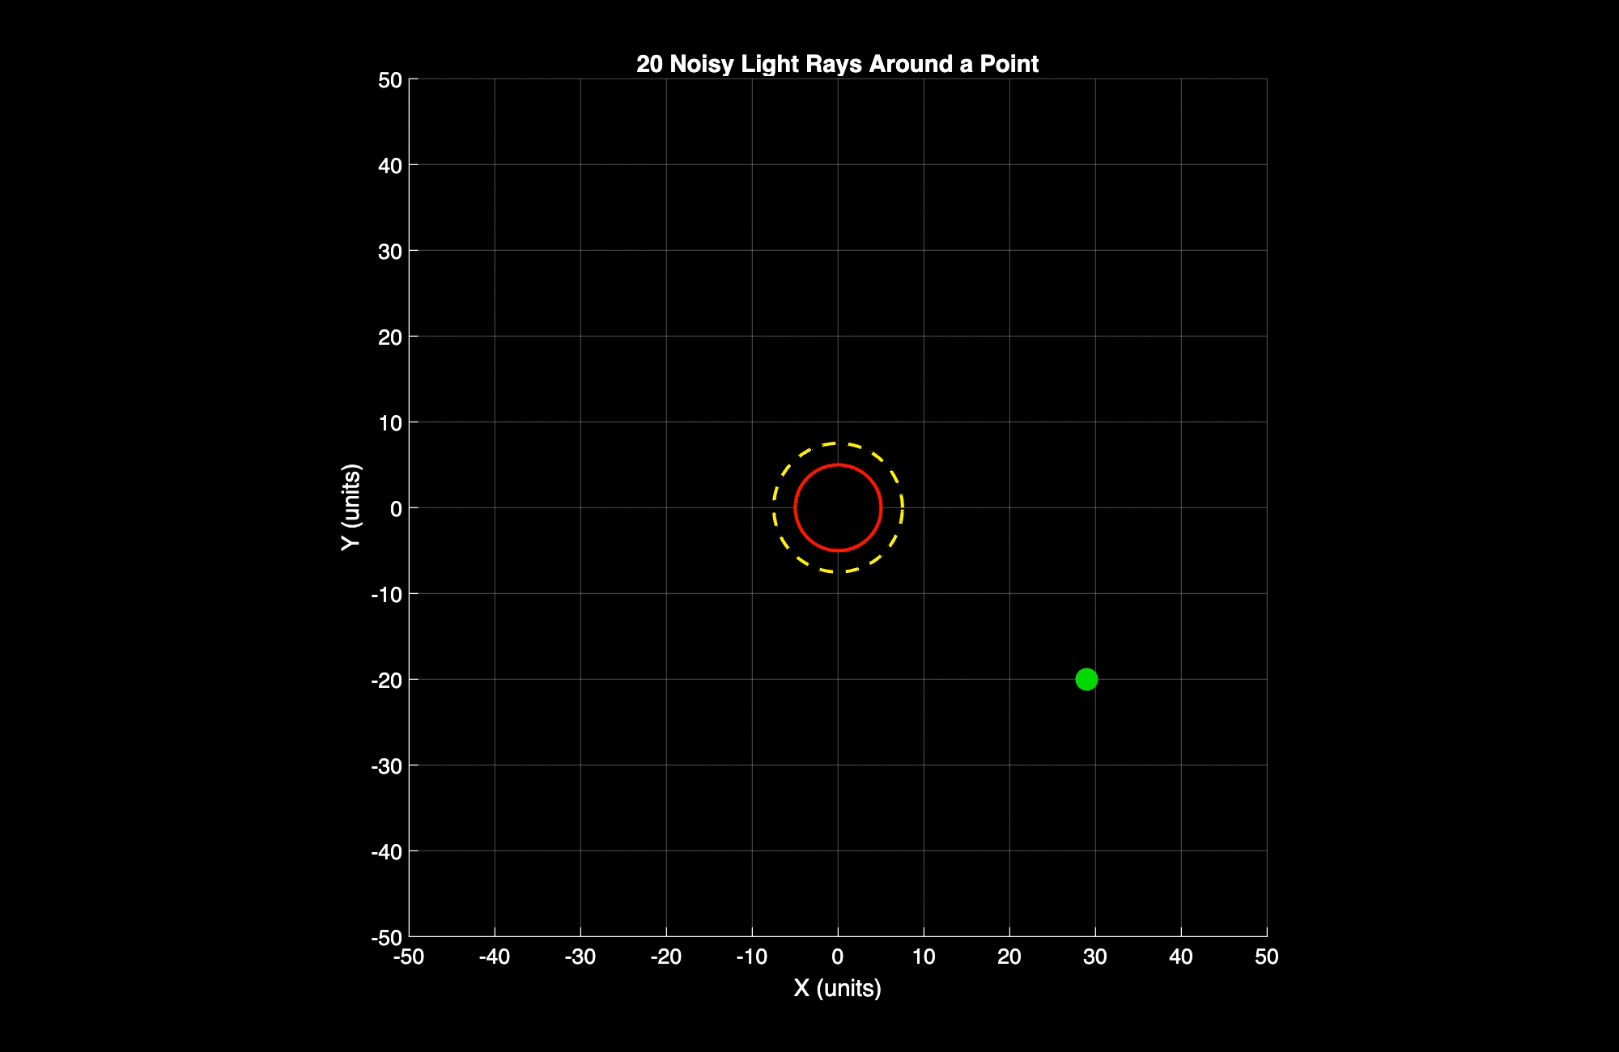
Notes:
(Xavier)

Slide 11
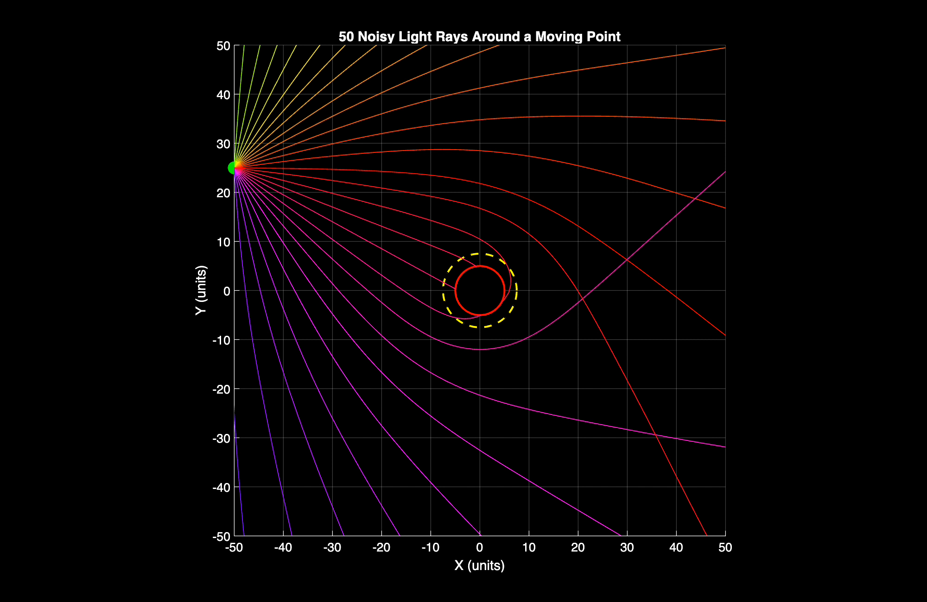
Notes:
(Xavier)

Slide 12
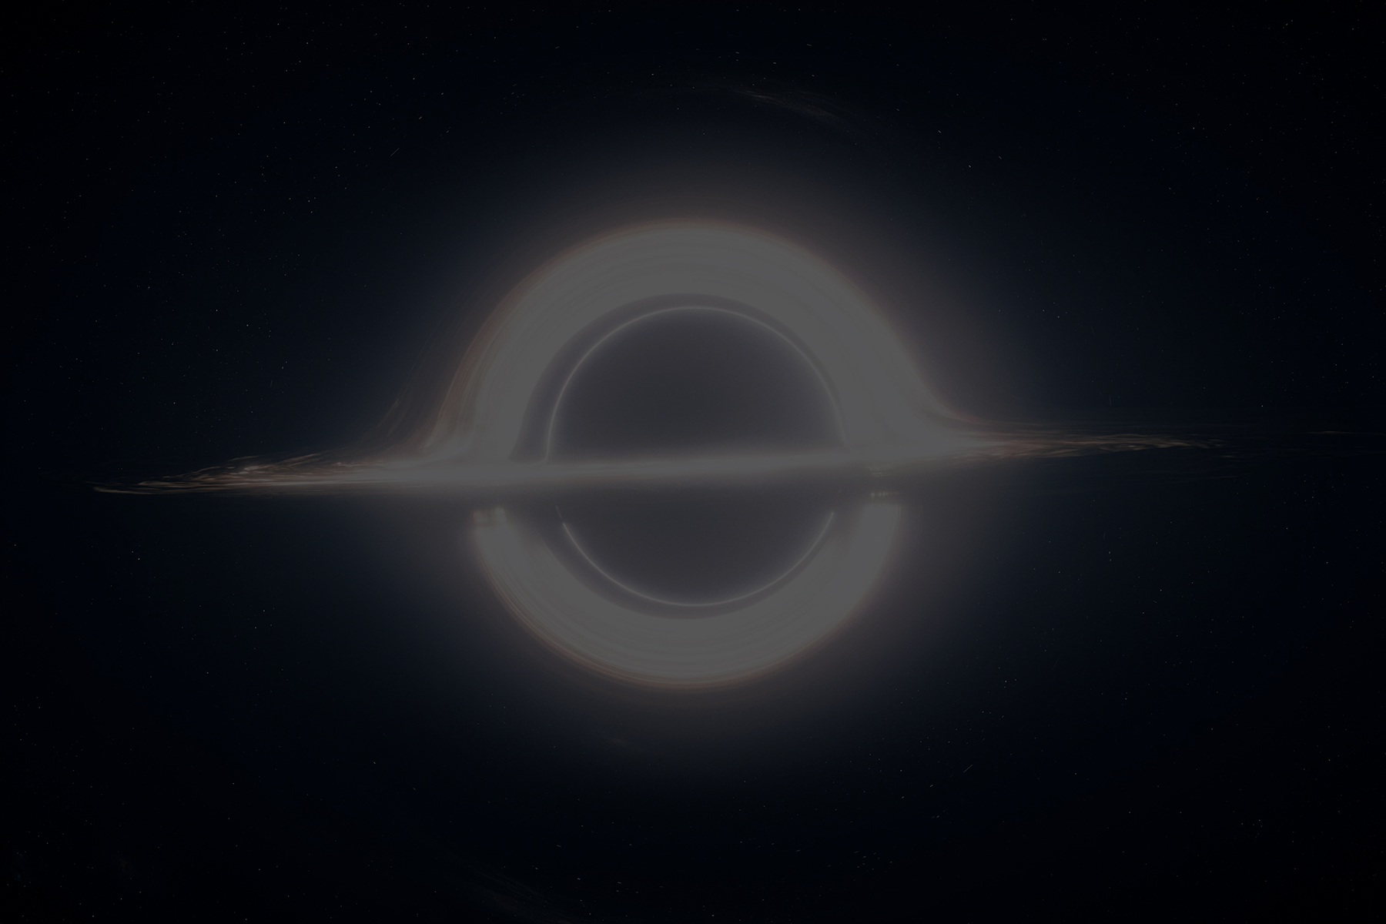
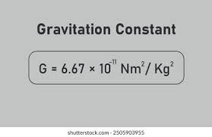
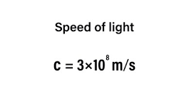
Challenges and Assumptions
Short time steps needed
Cannot get too random
G = c = 1
Geometrized units (expressed all with the same unit system)
Reduces equation complexity and numerical instability
Focus on physical behaviour rather than unit conversions
Notes:
What Challenges Do You Expect:
Numerical instability in ODE solutions.
Noise impact on results.
Assumptions:
Neglecting external disturbances. ( we quite literally assumed G = c = 1 )
(Xavier and Aayan)

Slide 13
Project Plans
Monte Carlo escape tests: Conduct tests for multiple randomly sampled initial light source positions and estimate how often a photon escapes or falls in.
Photon sphere interactions: Analyze how many sampled rays specifically enter the unstable region, orbit, and still managed to escape
Extend to 3D: Implementing a fully functional 3D simulation of photon motion around the black hole along the spacetime fabric.
Notes:
Specific Objectives and Case Studies
Are you looking to simulate some particular situations/environments?
Optional Simulation Goals:
Longer time-frame predictions.
Monte Carlo simulations for robustness analysis.
(Helitha ?)

Slide 14
Conclusion
We created a model that can simulate rays of light and their geodesic paths
Show how the curvature of spacetime affects photon trajectories, linking theoretical physics to practical numerical results.
Successfully used ODEs and implemented random noise
Shows how different initial conditions can impact results
Provides an example of how simulations can help understand complex phenomena that cannot be experimented on in real life
Notes:
Restate the importance of the project and its connection to the course concepts.
Highlight technical achievements so far.
Emphasise the potential for the project to contribute to understanding modeling and simulation principles.
(Helitha ?)

Slide 15
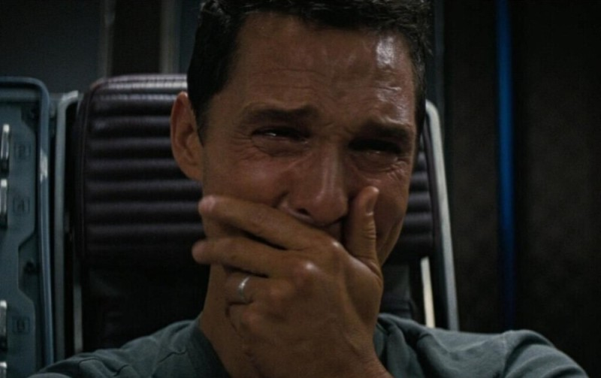
Thanks for listening!
Notes:
This Is funny

